Slide 1

Intermediate JavaScript Intro to Functional Programming
- Afnan Sherbeeni - Mohamed Ibrahim - Abdulrahman Almudaiheem SABBAR - Idea: on-demand staffing platform for gig workers - Funding: SAR 21 Million
- Stats: 130,000 registered, 300+ companies
Ismail Al Kamal
Session 05
Notes:
Line spacing + Page numbers

Slide 2
Agenda
01 Weekly Scrum 8:05
02 FP Introduction 8:10
03 FP Exercise 8:30
04 Break 9:00
05 JS Functional Syntax 9:10
06 FP Exercise 9:30
07 Q&A 9:50

Slide 3
Weekly Scrum
01

Slide 4
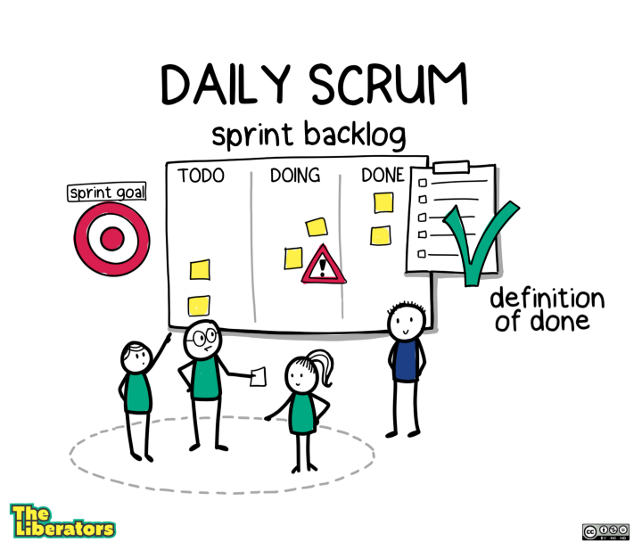
Weekly Scrum
01
WEEKLY
What did you do last week?
What will you do next week?
Any issues or problems?
source

Slide 5
Design Patterns
02

Slide 6
Design Patterns
02
Factory Functions
Module Design Pattern
Revealing Module Design Pattern

Slide 7
JavaScript Classes
03

Slide 8
JavaScript Classes
03
Constructors
Methods
Setter, Getter
Private properties
Static Methods
Class Inheritance
Polymorphism

Slide 9
Break 10 minutes
04

Slide 10
Constructor Functions
05

Slide 11
Constructor Functions
05
Constructor Functions
Prototypes
Prototypal Inheritance

Slide 12
Dinosaurs Project
06

Slide 13
Dinosaurs Project
06
Check the finished product
Check the Rubric
Review the starter code
Emphasize the deadline

Slide 14
Q & A
07

